Slide 1
Manav Institute Of Education
(Annual Report 2024-25)

Slide 2
Contents:
Events
Executive Summary
Committee Composition
Advisors and Consultants Roles & Responsibilities
Functions of the Committee
Vision
Mission
Goal
Strategies for Financial Mobilization
Photos

Slide 3

Manav Institute, Jevra, Hisar
Annual Report ( 2024-25)
Events Academic Year 2024-25
Sr. No. | Event Name | Date | Description | Guest Name
1. | International Yoga Day | 21.07.2024 | Yoga Day was celebrated on 21st June 2024 in Manav Institute of Education to raise awareness about physical, mental and spiritual benefits of yoga. The event included activities such as mass yoga sessions, educational seminars to encourage people to incorporate yoga into their daily lives ,tree plantation, slogan writing, poster-making. Students and faculty actively participated and took a pledge to keep themselves physically mentally and emotionally fit and healthy. | Sh. Naresh Selwal
2. | Swachhta Abhiyan | 02.10.2024 | Manav Institute organized Swachhta Abhiyan 2024 on 2nd October 2024 to commemorate the birth anniversary of Mahatma Gandhi and to promote awareness about cleanliness and hygiene. Students, faculty, and staff participated in a cleanliness drive across the campus and nearby areas.The event included awareness rallies, poster-making, and slogan-writing activities. | Dr. Kiran Bagri
3. | Annual Function | 21.12.2024 | In Manav Institute the Annual Function was organized to celebrate the academic and cultural achievements of students. The event included students performances, prize distribution, and speeches by staff. | Sh. Ranbir Gangwa

Slide 4
4. | Festival Celebration (Lohri) | 13.01.2025 | Manav Institute celebrated Lohri, the traditional Punjabi festival, on 13th January 2025 with great enthusiasm and cultural spirit., The atmosphere was filled with warmth, laughter, and festivity. Sh. Deepak Gaur addressed students. | Sh. Deepak Gaur
5. | Sports Day Celebration | 06.02.2025 | The Annual Sports Day at Manav Institute is a vibrant celebration of physical fitness, teamwork, and sportsmanship. Students from various departments participate in a range of athletic competitions including track races, relay events, tug-of-war, long jump, and fun games. Facilities like the sports arena and outdoor grounds will be utilized, supported by the Sports Science Centre. | Dr. Kamal Gupta
6.. | Career Counselling | 03.03.2025 | Career Counselling session was organized to guide students on career opportunities, higher education, and industry readiness. The session emphasized competitive exam preparation, higher studies in Pharmacy, admissions, career and entrepreneurship options. | Sh. Kulwant Singh
7. | Award Ceremony | 25.03.2025 | In Manav Institute the Annual Function was organized to celebrate the academic and cultural achievements of students. The event included students’ performances, prize distribution, and speech by Dr. C.P. Gupta. | Dr. C.P. Gupta
8. | Poster Making | 18.04.2025 | Manav Institute organized a Poster Making Competition on 18.04.2025, encouraging students to showcase their creativity and awareness on socially relevant themes through visual art. The competition aimed to promote self- expression, artistic talent, and the power of visual communication. | Dr. Seema Gupta

Slide 5
Institutional Development Plan
(2024-2029)
MANAV INSTITUTE OF EDUCATION
Executive Summary:
Manav Institute of Education is committed to quality-driven education, research advancement, and community engagement in line with NAAC benchmarks. This Institutional Development Plan (2024–2029) focuses on achieving academic excellence, accreditation Infuse global competencies and foundational literacy-numeracy awareness. Align with NEP 2025, emphasize inclusive and digital teaching This Institutional Development Plan (IDP) provides a roadmap for comprehensive transformation in the areas of academics, infrastructure, governance, outreach, and quality assurance, thereby enhancing the institute’s eligibility and effectiveness for NAAC accreditation and long-term excellence in teacher education.

Slide 6
Committee Composition:
Name | Designation | Area of Expertise
Dr. C. P. Gupta | Chief Academic Advisor | Academic Planning, OBE, Curriculum Reform
Dr. Seema Gupta | Research & Quality Consultant | NAAC Documentation, Research, SSR/AQAR
Dr. Kiran Saini | Institutional Development Coordinator | Education, Faculty Development, Policy Implementation
Mr. Rammehar | Governance & Policy Advisor | Institutional Governance, Strategic Planning, Ethics
Dr. Heena Mittal | Innovation & Industry Linkage Advisor | Research Innovation ,Education Sector Collaboration

Slide 7
Advisors and Consultants Roles & Responsibilities:
Dr. C. P. Gupta: Lead academic audits, curriculum benchmarking, and mentoring for outcome-based learning systems.
Dr. Seema Gupta: Supervise NAAC documentation, IQAC process enhancement, and research quality improvement.
Dr. Kiran Saini: Act as the central coordinator for implementing IDP strategies and driving internal reforms.
Mr. Rammehar: Guide policy formation, institutional code of conduct, and participative governance structure.
Mrs. Heena Mittal : Promote Education Sector collaborations, , and entrepreneurship incubation.
Functions of the Committee:
Prepare and review the Institutional Development Plan (IDP)
Align institutional goals with NAAC’s 7 Criteria and NEP 2025
Conduct internal quality audits and mock NAAC assessments
Facilitate faculty training, seminars, and best practice workshops

Slide 8
Vision
The Focus of management is basic in rural area and special emphasis is on women education. As per this vision most of students are women and belongs to rural areas. Management always provide special scholarship program for girls who are in merit from rural areas. The college works on the motive IF “WOMEN OF RURAL AREA IS EDUCATED ONLY THEN COUNTRY WILL GROW”.
Component | Explanation
1. National Recognition | The institute aims to gain wide recognition across India through academic quality, research output, and community contribution.
2. Center of Excellence | Focus on achieving high standards in teaching, learning, infrastructure, and student outcomes, making the institute a model for pharmacy education.
3. Education | Delivering outcome-based, industry-aligned education that equips students with theoretical and practical expertise in all core areas of

Slide 9
Component | Explanation
4. Research and Innovation | Encouraging faculty and students to undertake cutting-edge research, publish in reputed journals, and develop innovative educational programs. Like FDP’s, Orientation programs and Seminars.
5. Competent Professionals | Developing skilled graduates who are capable of contributing meaningfully to become a good teacher and work for people wellbeing.
6. Ethical Values | Promoting honesty, integrity, and responsibility in both academic and professional conduct.
7. Social Responsibility | Encouraging students and staff to engage in reaching rural areas and provide knowledge to then about awareness of education and how being educated is important in this society.

Slide 10
Purpose of This Vision:
This vision guides long-term institutional planning, resource allocation, and academic strategies. It ensures that every action taken over 2024–2029 aligns with the aspiration to become a leader in pharmacy education and a contributor to national healthcare development.
Mission
- To empower teacher trainees with knowledge, skills, and values for inclusive education.
- To foster critical thinking, innovation, and ethical practices.
- To engage with the community through extension and outreach programs.
Mission Statement (2024–2029)
Academic Excellence: Semester-wise Planning and Scheduling, Development of e-Content and PowerPoint Lectures, Remedial classes for Weak Students
Faculty Development Initiatives: FDP on “Pedagogical Innovations”, Participation in Online Refresher Courses, Incentives for Paper Publications and Conferences
Student Support and Progression: Mentorship Program, Soft Skills and Spoken English Classes
Learning Resources: Smart Boards and Audio-Visual Labs, ICT-enabled Classrooms
Curricular Aspects: Lesson Planning as per Constructivist Pedagogy, Field Visits, School Internship, and Teaching Practice

Slide 11
Goal 1: Achieving Accreditation and Advancing Autonomy (2024–2029) Objective:
To achieve NAAC accreditation and subsequently apply for institutional autonomy to enhance academic and operational flexibility.
Key Focus Areas:
Initiate the NAAC accreditation process through self-assessment and compliance with quality benchmarks.
Strengthen academic, administrative, and infrastructural systems to meet NAAC criteria.
Engage expert advisors to guide the accreditation journey and ensure quality enhancement.
Post-accreditation, apply for UGC-recognized autonomy to promote curriculum innovation, faculty empowerment, and improved institutional governance.
Goal 2: Advancing Academic Programs (2024-2029) Objective: Align with NEP 2025
Key Focus Areas: Align with NEP 2025, emphasize inclusive and digital teaching, Infuse global competencies and foundational literacy-numeracy awareness.

Slide 12
🔹 Curriculum Enrichment:
Modernize Content: Upgrade all to smart classrooms. Expand lab, high-speed Wi-Fi, simulation software. Modernize with projector, podium mic, digital board
Flexible Learning: Develop digital library, N-LIST & e-resources access. Establish language lab for multilingual pedagogy. Train in three-language pedagogy approach
Promote Research Culture: Extend to 12 weeks with mentoring, action research. Integrate NEP-aligned modules (Foundational literacy, socio-emotional skills)
Goal 3: Research Advancement and Innovation Ecosystem
Objective: To build a dynamic research ecosystem and innovation culture in education through specialized centers, high-quality output, and in the areas of academics, infrastructure, governance, outreach, and quality assurance, thereby enhancing the institute’s eligibility and effectiveness for NAAC accreditation and long-term excellence in teacher education.
Key Focus Areas:
🔹 Research Infrastructure:
\
Extensive school-based practice, reflection journals, and feedback.
ICT-enabled teaching, group discussions, role-play, microteaching.
Faculty mentorship for academic and personal guidance.
🔹 Faculty and Student Research Promotion:

Slide 13
Provide grants and seed funding for research projects.
Encourage publications in UGC listed and indexed journals.
Support participation in national/international conferences, and seminars.
🔹 Innovation, Patents & Commercialization
Conduct workshops and EDP’s
Encouragement for Faculty Research Publications
Goal 4: Institutional Infrastructure Enhancement (2024–2029)
Objective: To enhance academic, research, and student-centered infrastructure to support high-quality education and innovation.
Key Focus Areas:
🔹 Development of Research Ecosystem:
Introduction of ICT-enabled teaching practices
Focus on hands on practical
Initiate bridge program to gap language barrier
Academic & Student Spaces:
Expand interactive classrooms with smart teaching tools.
Develop student-centric areas such as study lounges, research corners, and collaborative workspaces.
🔹 Digital Learning Resources:

Slide 14
Strengthen access to global journals, e-books, and databases.
Launch a dedicated e-learning platform for online courses, webinars, and digital learning modules.
Goal 5: Faculty Development and Retention (2024–2029)
Objective: To build and retain a highly qualified faculty capable of delivering excellence in teaching, research, and community engagement.
Key Focus Areas:
🔹 Faculty Recruitment and Training:
Attract experts in Education in their respective subjects through competitive hiring strategies.
Conduct regular faculty development programs, research seminars, and provide access to online learning platforms.
🔹 Incentivizing Excellence:
Introduce awards for outstanding performance in teaching, research, and service.
Support faculty through sabbaticals, research leave, and international collaboration opportunities.

Slide 15
Mission Brief:
. Curriculum Excellence:
Implementation of outcome-based education, ICT tools, and value-added courses.
. Faculty Development:
Continuous training, research promotion, and transparent recruitment.
Student Empowerment:
Skill development, placements, mentoring, and holistic growth.
Research & Innovation:
Strengthening research culture, innovation hubs, and entrepreneurship.
Infrastructure Upgradation:
Smart classrooms, lab modernization, digital library, and green campus initiatives.
Quality Assurance:
Enhanced IQAC functioning, data-driven planning, and internal audits.
Community Outreach:
Health camps, NSS activities, and promotion of social responsibility.
Strategies for Financial Mobilization (2024–2029)
Availing government grants from UGC AICTE NCTE
Generating revenue through industry-sponsored research and testing services
Establishing alumni association for donations scholarships and infrastructure support

Slide 16
Signing MoUs with eduactionall institutes for sponsored student teacher training programs
Introducing self-financed certificate and diploma programs in emerging educational fields.
Partnering with schools for recruitment of our students as teachers for teaching
Seeking funding from NGOs trusts and philanthropic foundations for institutional development
No of students appeared in last three years:

Slide 17
2024
Programme Name | Programme Code | Number of Seats sanctioned | Number of Students Admitted
B.Ed | 1246 | 100 | 100
D.El.Ed | 506018 | 50 | 50
2023
Programme Name | Programme Code | Number of Seats sanctioned | Number of Students Admitted
B.Ed | 1246 | 100 | 100
D.El.Ed | 506018 | 50 | 0
2022
Programme Name | Programme Code | Number of Seats sanctioned | Number of Students Admitted
B.ed | 1246 | 100 | 100
D.El.Ed | 506018 | 50 | 50

Slide 18
Manav Institute develope a structured mechanism for conscious, consistent, and catalytic action to improve the overall performance of the institution. Recognizing that quality enhancement is a continuous process,
We Commit:
To establish a systematic approach for quality assurance and enhancement
To promote a learner-centric and participative teaching-learning environment
To embed best practices and benchmarks across departments and functions To ensure effective documentation, monitoring, and internal quality audits
Manav Institute,
VILL. JEVRA, BARWALA ROAD, HISAR
E-Mail: info@manavinstitute.com.
Web:www.manavinstitute.com

Slide 19
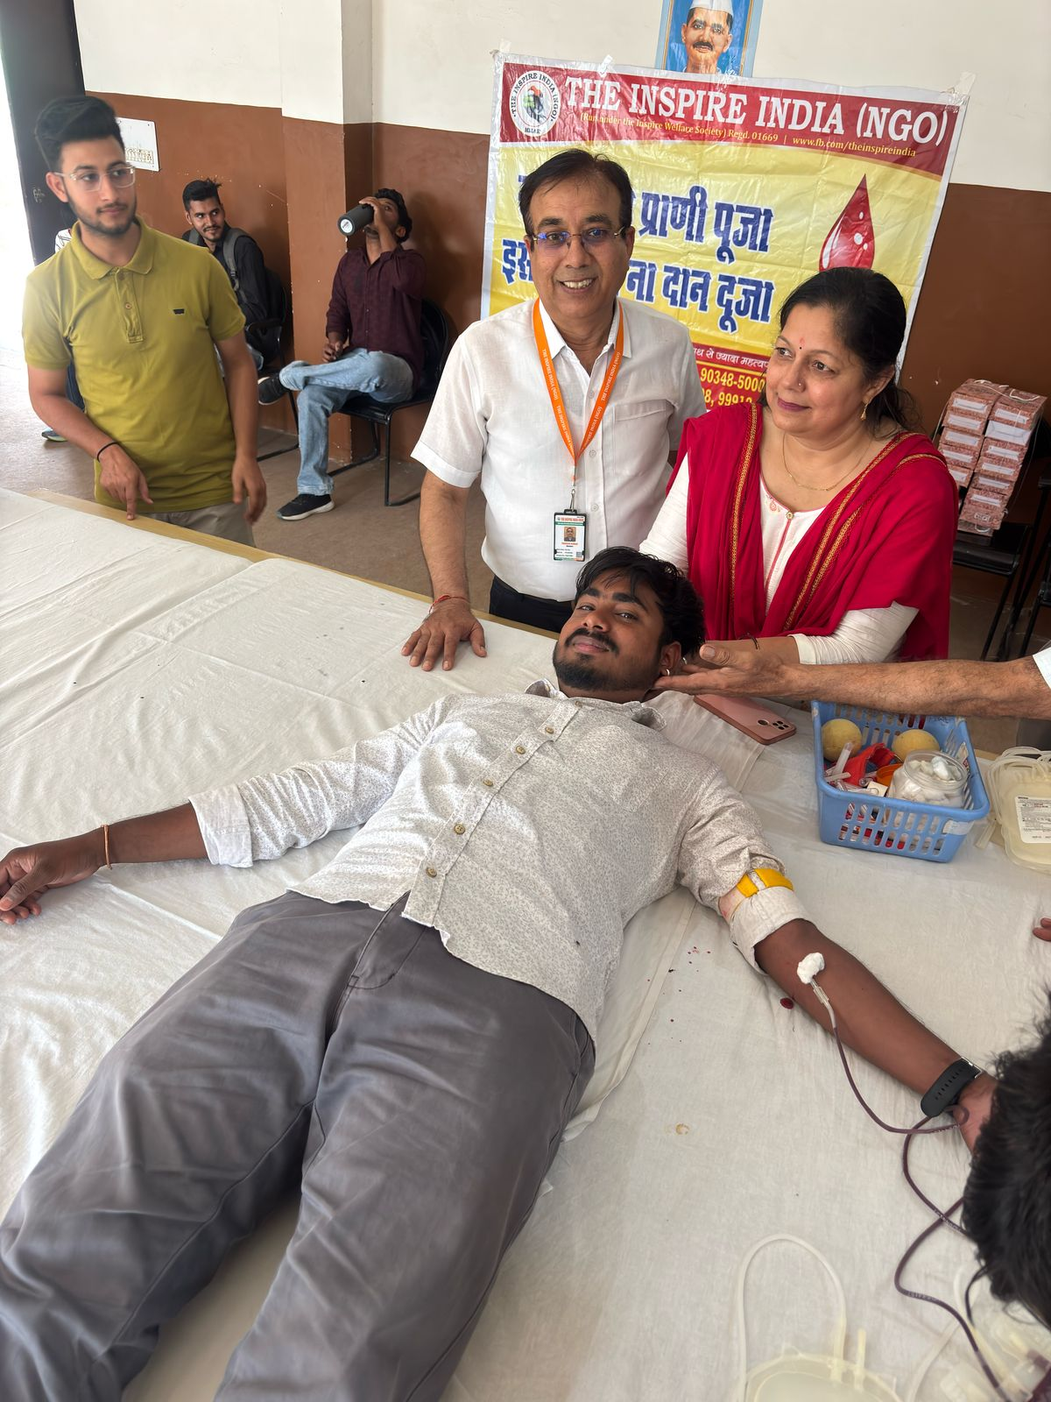
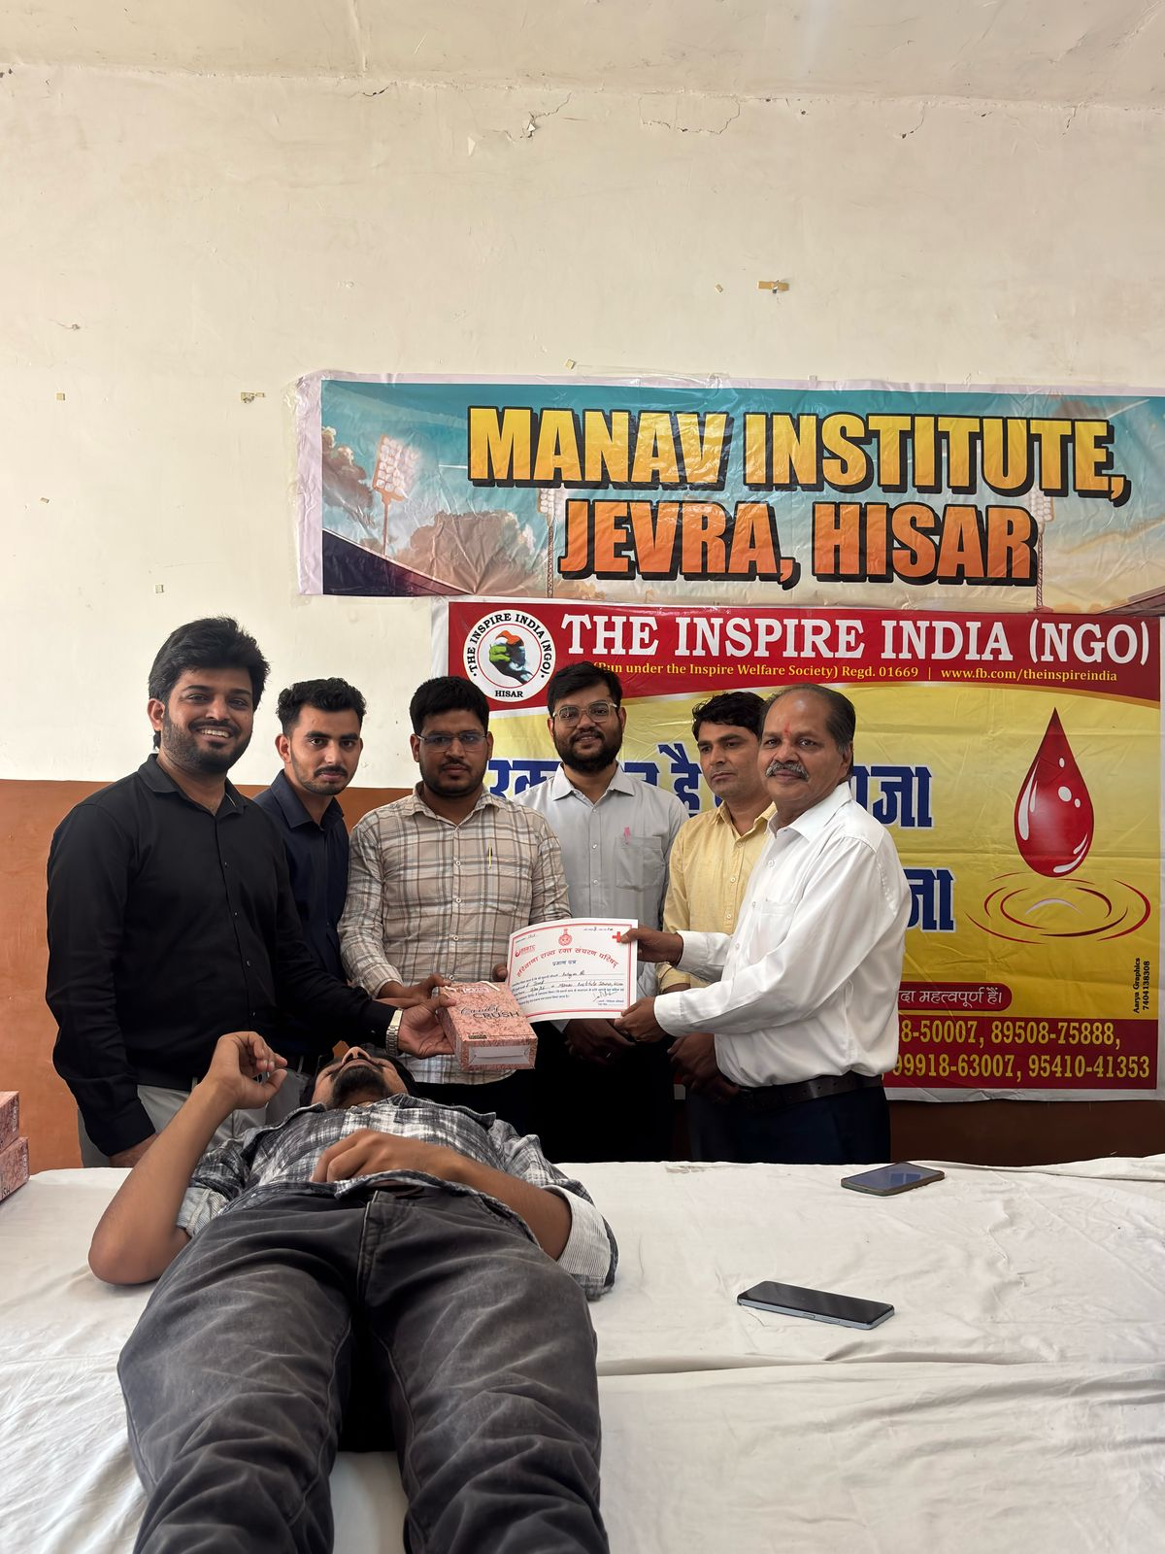

Slide 20
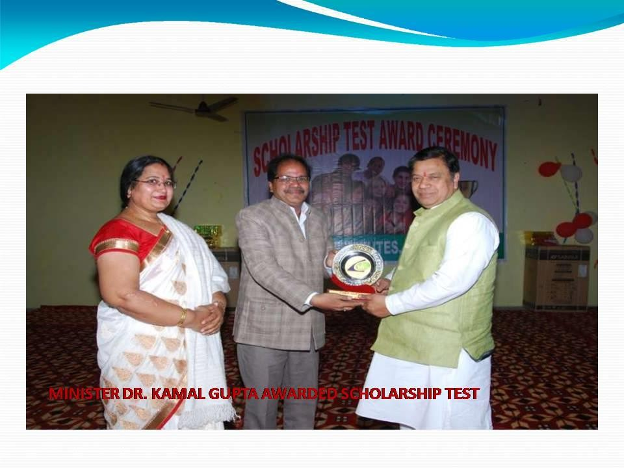
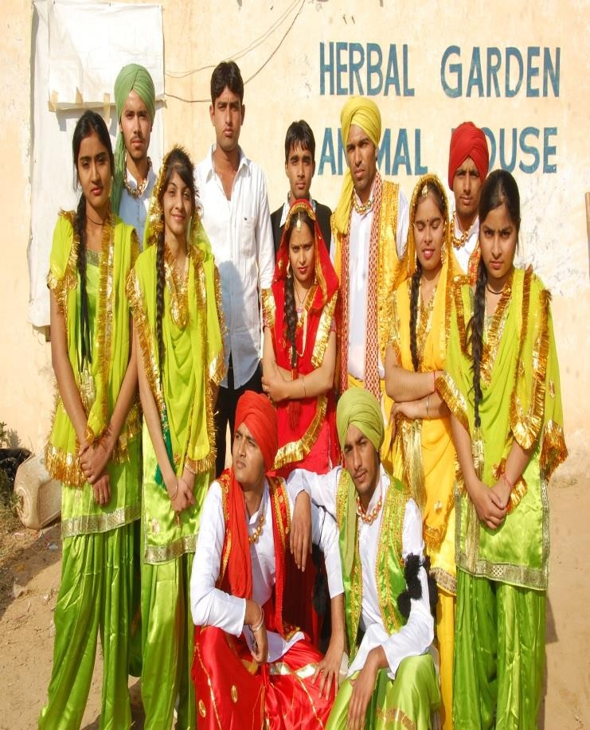

Slide 21
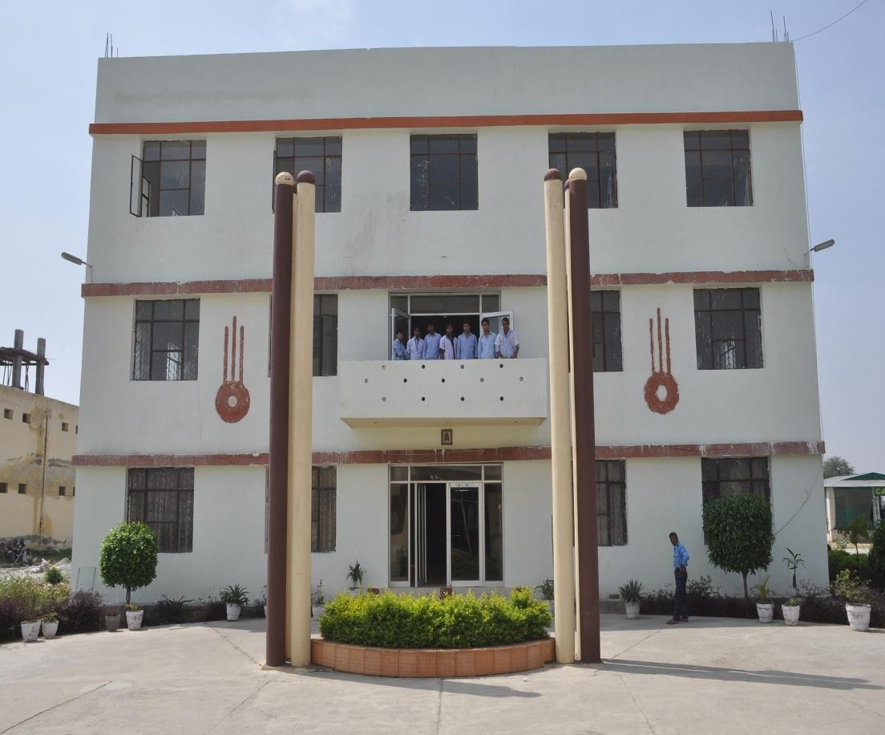
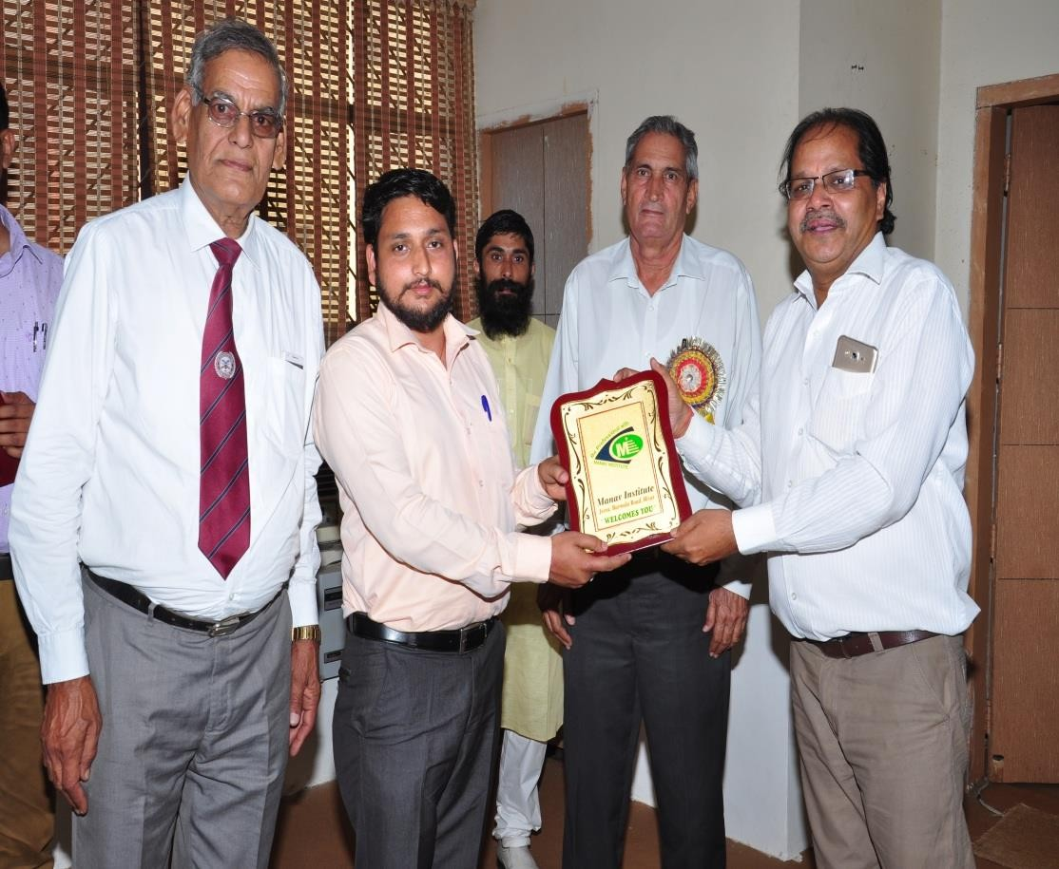

Slide 22
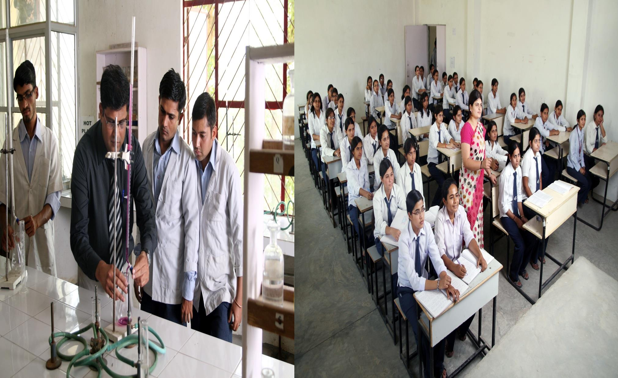

Slide 23
Thanks

